Slide 1


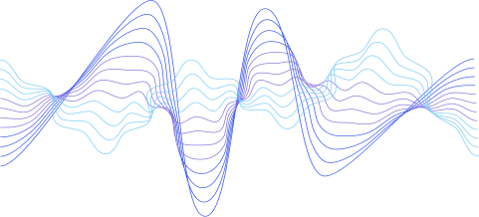
FREELANCE JOB PORTAL
PRESENTED BY TEAM NEW BALANCE
TEAM MEMBERS
HASSAN AFZAL 22I-0918
ASJADULLAH 22I-1227
RAZA KHAN 22I-1234

Slide 2


PURPOSE
GOALS
The purpose of New Balance – Freelance Job Portal is to bridge the gap between talented freelancers and clients seeking specific project-based services.
Streamline job posting and bidding
Enable real-time communication and feedback
Create a secure and efficient freelancing platform

Slide 3

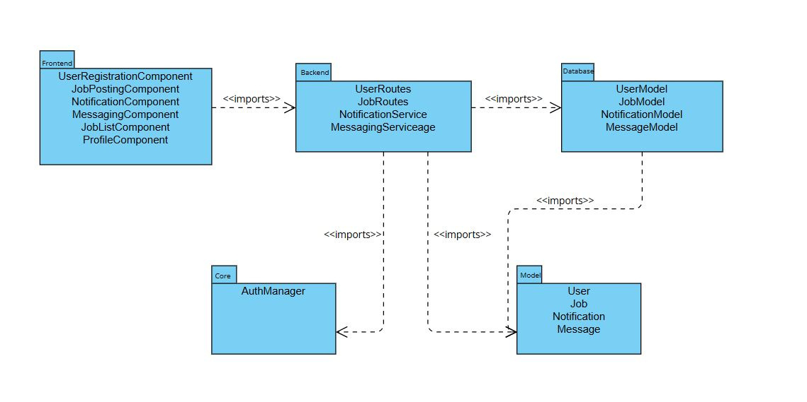

ARCHITECTURE
PACKAGE DIAGRAM

Slide 4
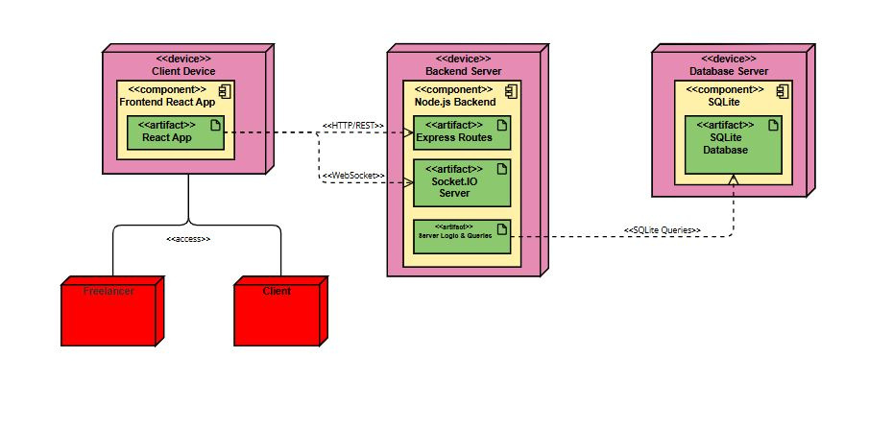
ARCHITECTURE
DEPLOYMENT DIAGRAM

Slide 5
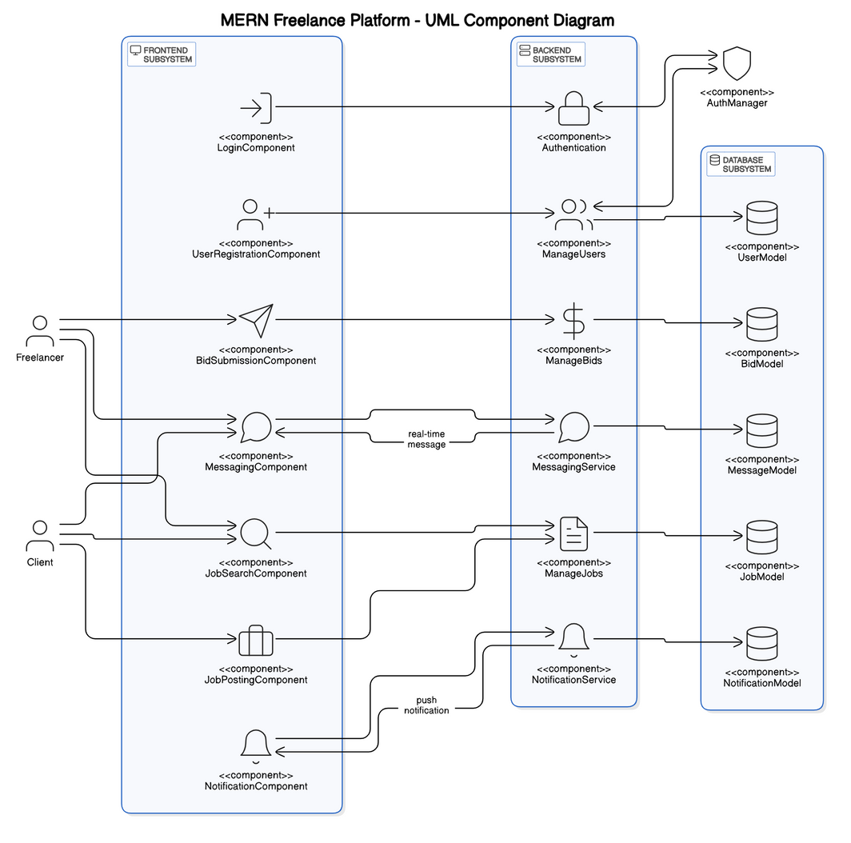
ARCHITECTURE
COMPONENT DIAGRAM

Slide 6
PROJECT PLANNER
WBS
Sprint Summary
Project Initiation
Frontend Development
Frontend Development
Testing
Maintenance
SPRINT 1
User Registration
User Authentication
Profile Management
Job Posting
Job Search
SPRINT 2
Bid Submission
Proposal Review & Approval
Freelancer Rating & Review
Client Rating & Review
Bookmarking Jobs
SPRINT 3
Job Completion
Custom Job Offer
Work History & Earnings Tracking
Real time notification
Messaging

Slide 7
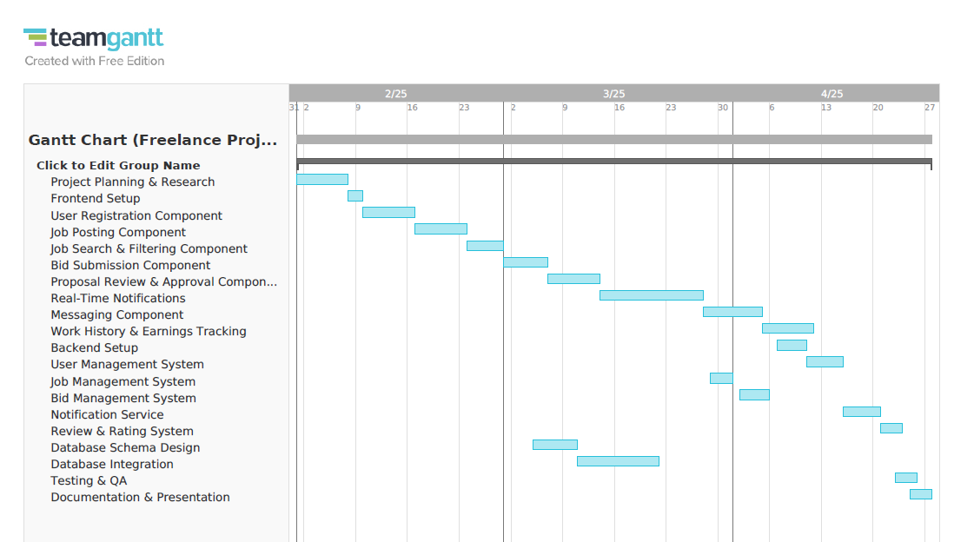
PROJECT PLANNER
GANTCHART

Slide 8
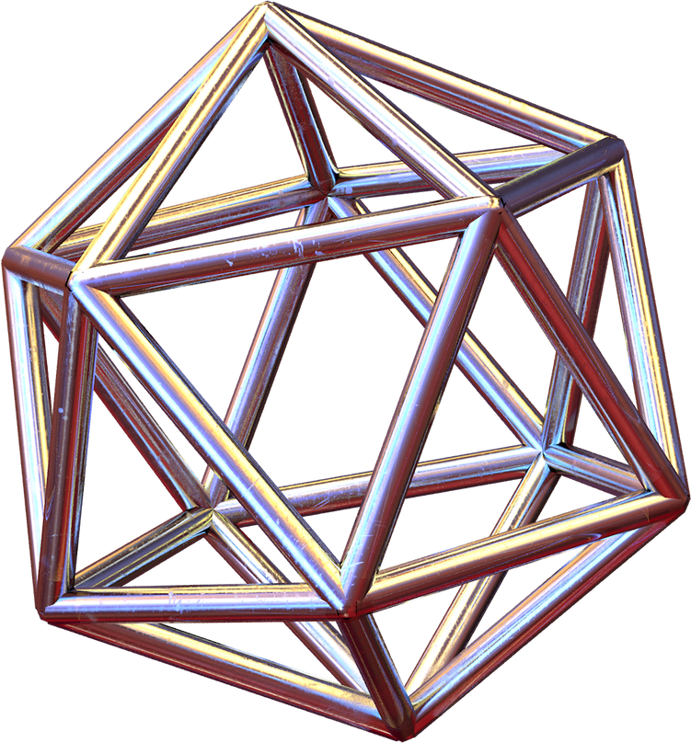
USER SRORIES
User Story 1: User Registration and Authentication
Goal: Allow users to create a secure account and access the platform with proper authentication.
Actors: Freelancer, Client
Pre-conditions: User has valid credentials and/or a supported third-party login method.
Post-conditions: User is redirected to their respective dashboard after successful registration or login.

Slide 9
USER SRORIES
User Story 2: Job Posting and Bidding
Goal: Enable clients to post jobs and freelancers to discover and submit proposals for those jobs.
Actors: Client, Freelancer
Pre-conditions: Client must be authenticated and have access to the job posting page; freelancer must be logged in.
Post-conditions: Job is listed publicly, and freelancers can view and apply via proposals.

Slide 10
USER SRORIES
User Story 3: Messaging and Real-Time Notifications
Goal: Facilitate real-time communication and updates between users.
Actors: Freelancer, Client
Pre-conditions: Both users must be logged in and have a previous interaction or job engagement.
Post-conditions: Messages and notifications are delivered in real time and stored for record keeping.

Slide 11


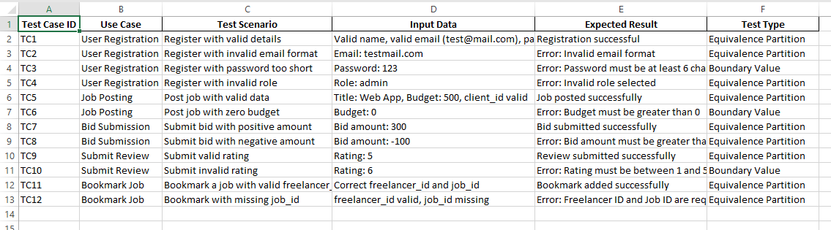
BLACK BOX TESTING

Slide 12
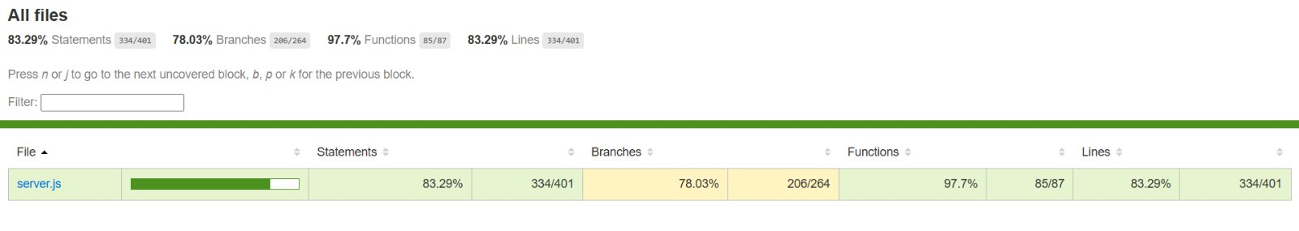
WHITE BOX TESTING
Statements (Acheived: 83.29%, Total lines/units 334/401)
Branches (Acheived: 78.03%, Total lines/units 206/264)
Functions ( Acheived: 97.7%, Total lines/units 85/87)
Lines (Acheived: 83.29%, Total lines/units 33)

Slide 13
FURTHER IMPROVEMENTS
Integration with payment gateway
AI-based freelancer recommendations
Dispute resolution system
Mobile app for clients and freelancers
Admin analytics dashboard

Slide 14
CONCLUSION
Lessons Learned
Applied Agile methodology with sprints and user stories
Gained hands-on experience in full-stack development
Improved team collaboration using Trello & GitHub
Understood the value of thorough testing and code coverage

Slide 15
CONCLUSION
Team Reflections
Sprints kept our work organized and focused
Regular updates helped avoid delays
Learned to integrate frontend, backend, and database smoothly
Final Thoughts
Real-world simulation of a freelance portal
Strengthened both technical and soft skills
Proud of building a scalable, working product

Slide 16
THANK YOU

